Slide 1
PRODIGY
Gamified Learning
110
A game based E-learning tool for
English grammar practice
By
Guy Manzurola
Academic Instructor
Dr. Meirav Taieb-Maimon
Notes:
Prodigy is a game based learning tool for English grammar

Slide 2
INTRODUCTION
In almost all areas of learning, knowledge is acquired through extensive and repetitive practice of the learned material.
This is especially true when learning a second language.
A popular means of providing learners with content is via digital devices, i.e. E-learning.

Slide 3
WHAT IS E-LEARNING?
Study anytime, at your own pace.
Delivered through digital devices (computer, mobiles etc.)
Cost-effective (no humans involved in teaching, provides automatic feedback)
Accessible

Slide 4

PROBLEM Keeping Learners Motivated
Engaging learners to the end of a course has become one of the most significant problems faced by E-learning developers.

Slide 5
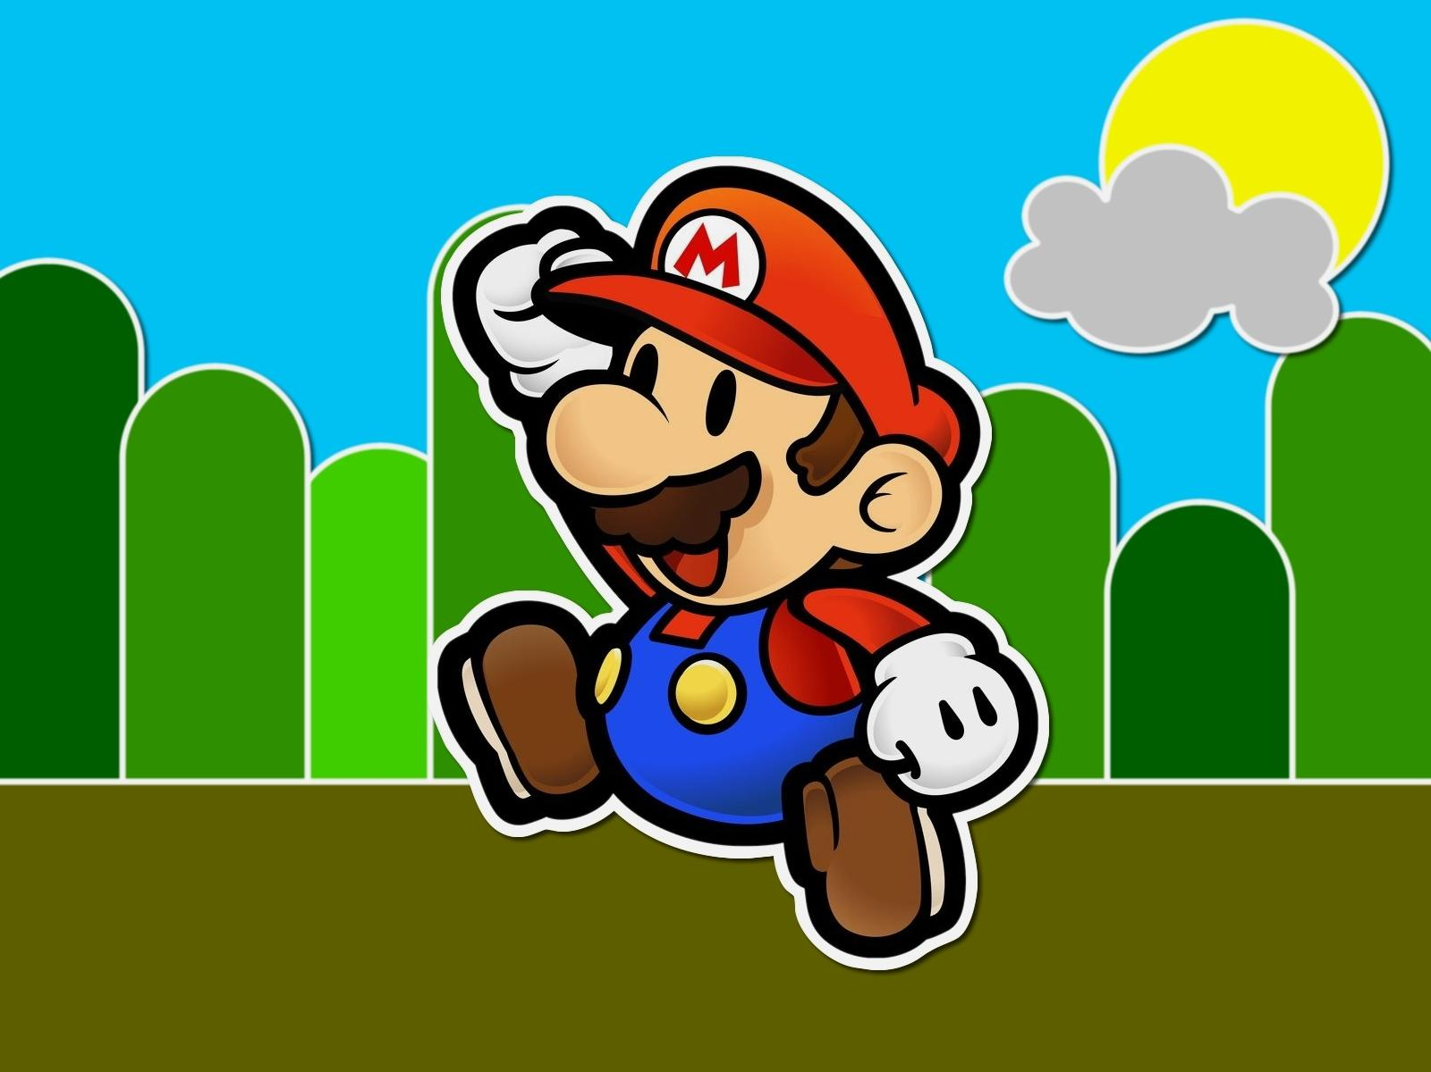
Engage Learners Through Games
SOLUTION
We all enjoy games, and when we enjoy ourselves, we learn better. Games are inherently motivating.

Slide 6
GOAL
Engage English grammar learners using design principles from computer games.

Slide 7
Core
Subject
selects
1..*
Exercise
selects
Question
solves
1..*
Player
1..*
Blank
fills
1..*
Answer
chooses
Feedback
receives
0..1

Slide 8
Design principles in action
Challenge, Fantasy, curiosity
Mistakes -> Lose Health
Blanks -> Stars
Challenge, Fantasy
Challenge, Fantasy
Challenge
Score
Hints
curiosity
Players play to achieve a top score
Combo!
Challenge, curiosity
Players are rewarded more points on consecutively submitted correct answers. Visual feedback changes.

Slide 9
PROMO
LIVE DEMO
PRODIGY

Slide 10





BEHIND the SCENES (example)
Exercise data: questions, blanks, answers, hints
3
Data Tier
JSON formatted data
4
2
Get exercise data where exercise id = ‘1’
Middle Tier
1
Client Tier
GET /exercises/1

Slide 11
ENGINE DEVELOPMENT
Based on Douglas Crockford’s functional inheritance.
Excellent support for separation of concerns and abstraction of data.
Entity
+Remove()
+AppendTo(parent)
+FireEvent(event)
+On(event, handler, args)
…
Welcome
Gameover
Question
Score
Answer
…
…
screens
plugins

Slide 12
TESTING
Integral in the development process.
Each unit developed was tested independently and then integrated.
Client Side – plugin development.
Server Side – Resource development.

Slide 13
EXPERIMENTS
Application is deployed and accessible to the world.
Positive feedback from demo.
Usability testing Pending..

Slide 14
CHALLENGES
New Technologies
Requirement Elicitation

Slide 15
LESSONS LEARNED
PROTOTYPE,
PROTOTYPE,
PROTOTYPE !
Design, but not too much.

Slide 16
IN THE FUTURE..
More game modes
More robust game progression (finish x to unlock y)
User profiles to store game progression
Game scoreboards
Administrator module to manage exercises
Cloud deployment
Multiplayer

Slide 17
FIN
Thank you &
GOOD LUCK!

